Slide 1


Sampling and Reconstruction of Analog Signals
Chapter Intended Learning Outcomes:
(i) Ability to convert an analog signal to a discrete-time
sequence via sampling
(ii) Ability to construct an analog signal from a discrete-time
sequence
(iii) Understanding the conditions when a sampled signal
can uniquely represent its analog counterpart
Y. Chen
Page 1
Semester A, 2022-2023

Slide 2





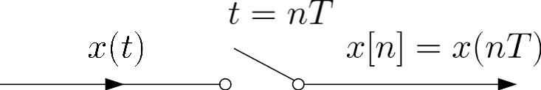
Sampling
. Process of converting a continuous-time signal into a
discrete-time sequence
. is obtained by extracting every s where is
known as the sampling period or interval
sample at
analog
signal
discrete-time
signal
Fig.4.1: Conversion of analog signal to discrete-time sequence
Y. Chen
Page 2
Semester A, 2022-2023

Slide 3


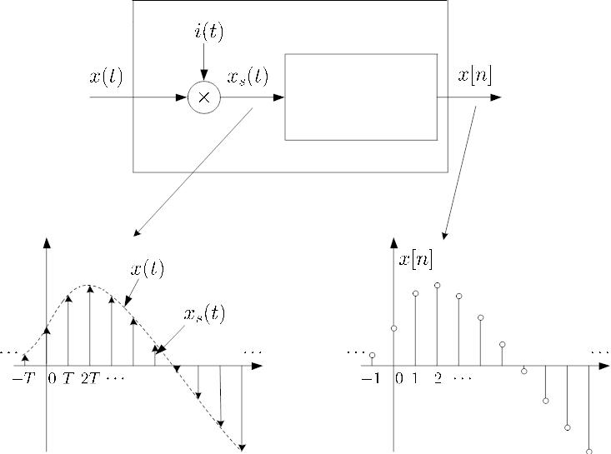
. Relationship between and is:
(4.1)
. Conceptually, conversion of to is achieved by a
continuous-time to discrete-time (CD) converter:
CD converter
impulse train
to sequence
conversion
t
n
Fig.4.2: Block diagram of CD converter
Y. Chen
Page 3
Semester A, 2022-2023

Slide 4
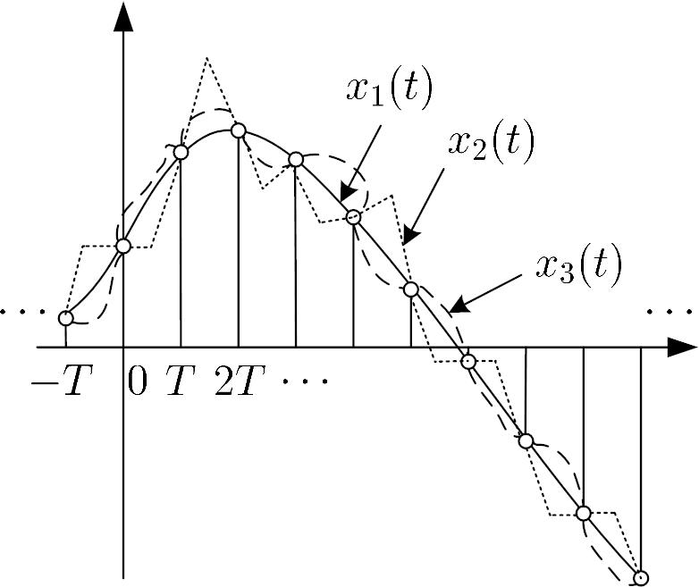
. A fundamental question is whether
can uniquely
represent or if we can use to reconstruct
t
Fig.4.3: Different analog signals map to same sequence
Y. Chen
Page 4
Semester A, 2022-2023

Slide 5






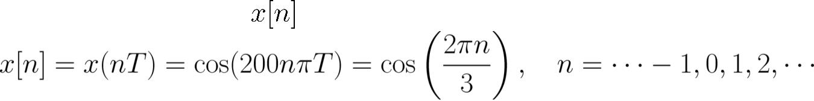



But, the answer is yes when:
(1) is bandlimited such that its Fourier transform
for where is called the bandwidth
(2) Sampling period is sufficiently small
Example 4.1
The continuous-time signal
is used as the
input for a CD converter with the sampling period
Determine the resultant discrete-time signal .
s.
According to (4.1), is
The frequency in is
while that of is
Y. Chen
Page 5
Semester A, 2022-2023

Slide 6


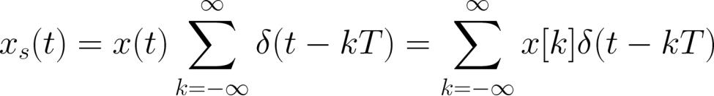


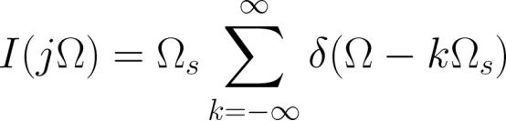
Frequency Domain Representation of Sampled Signal
In the time domain, is obtained by multiplying by
the impulse train
:
(4.2)
(or
with the use of the sifting property of (2.12)
Let the sampling frequency in radian be
in Hz). From Example 2.8:
(4.3)
Y. Chen
Page 6
Semester A, 2022-2023

Slide 7
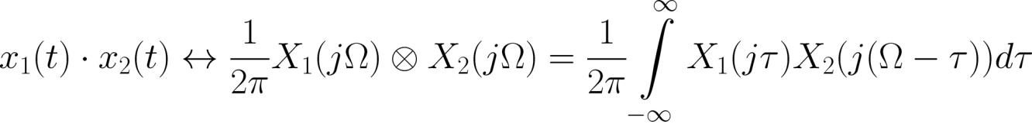


Using multiplication property of Fourier transform:
(4.4)
where the convolution operation corresponds to continuous-
time signals.
Using (4.2)-(4.4) and properties of ,
is:
Y. Chen
Page 7
Semester A, 2022-2023

Slide 8
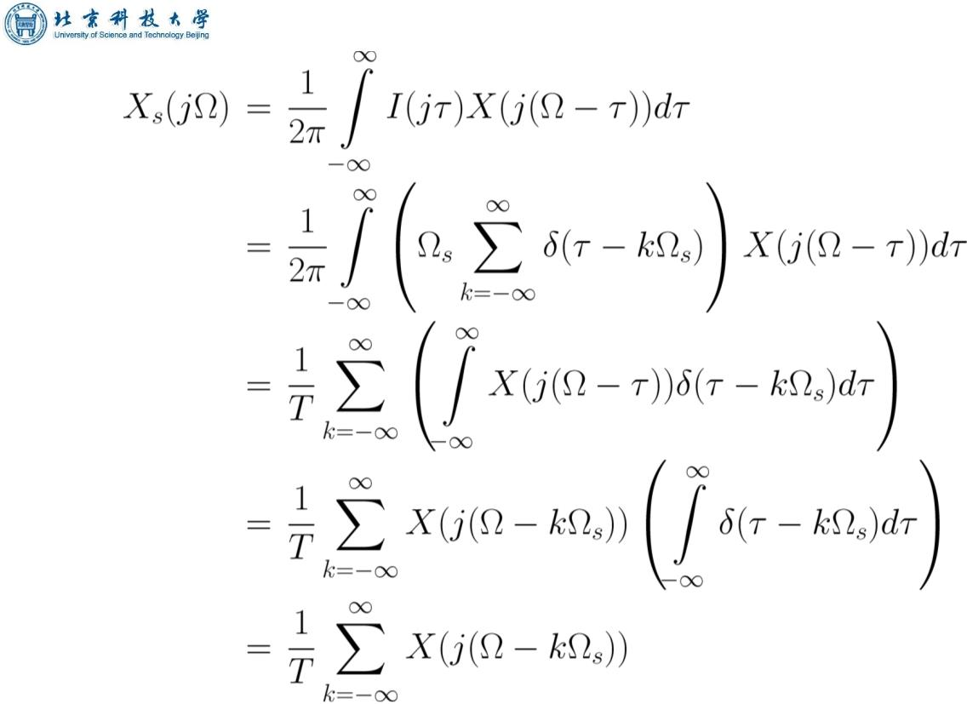


(4.5)
scaled by
which is the sum of infinite copies of
Y. Chen
Page 8
Semester A, 2022-2023

Slide 9





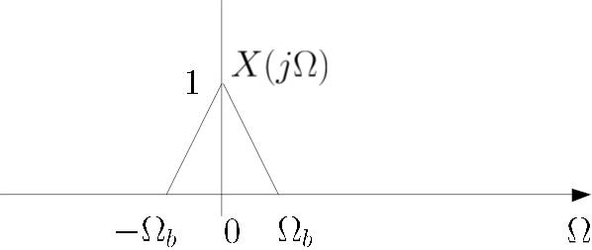
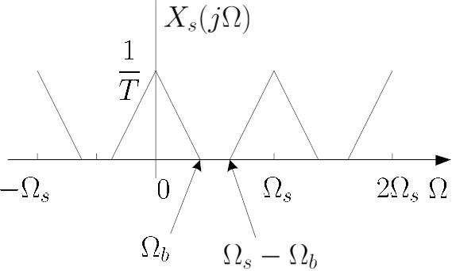
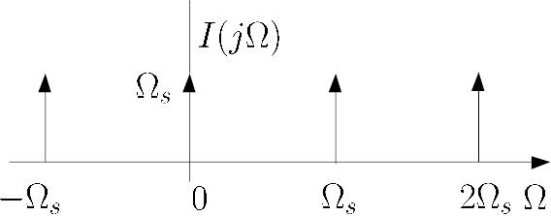


When is chosen sufficiently large such that all copies of
do not overlap, that is,
or
, we
can get
from
...
...
...
...
Fig.4.4:
for sufficiently large
Y. Chen
Page 9
Semester A, 2022-2023

Slide 10




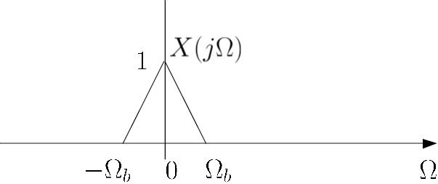
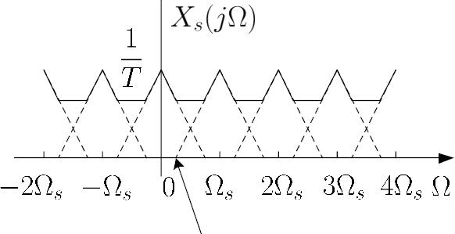
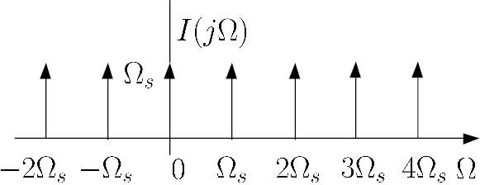

When is not chosen sufficiently large such that
copies of overlap, we cannot get from
which is referred to aliasing
,
,
...
...
...
...
Fig.4.5:
when is not large enough
Y. Chen
Page 10
Semester A, 2022-2023

Slide 11





Nyquist Sampling Theorem (1928)
Let be a bandlimited continuous-time signal with
(4.6)
Then is uniquely determined by its samples
, if
,
(4.7)
The bandwidth is also known as the Nyquist frequency
while is called the Nyquist rate and must exceed it in
order to avoid aliasing
Y. Chen
Page 11
Semester A, 2022-2023

Slide 12
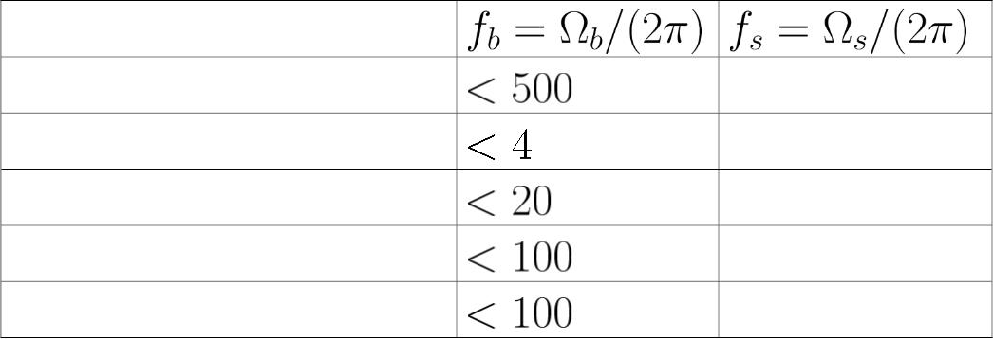
Application
Biomedical
Hz 1 kHz
Telephone speech kHz 8 kHz
Music
Ultrasonic
Radar
kHz 44.1 kHz
kHz 250 kHz
MHz 200 MHz
Table 4.1: Typical bandwidths and sampling frequencies in
signal processing applications
Example 4.2
Determine the Nyquist frequency and Nyquist rate for the
continuous-time signal which has the form of:
Y. Chen
Page 12
Semester A, 2022-2023

Slide 13




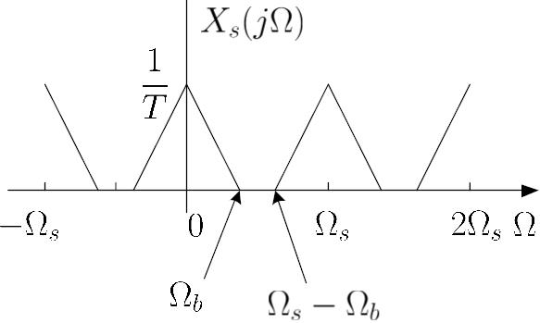
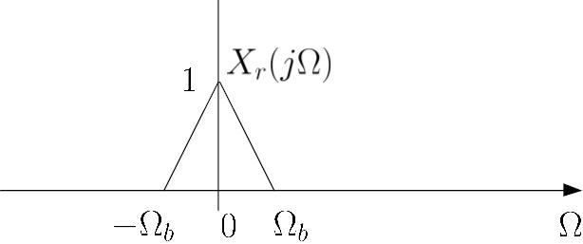
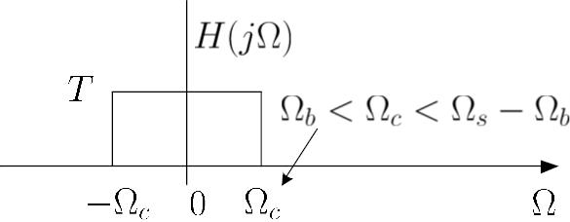






The frequencies are 0,
and
. The Nyquist
frequency is
and the Nyquist rate is
...
...
Fig.4.6: Multiplying
In frequency domain, we multiply
amplitude and bandwidth with
and
to recover
by
with
, to
Y. Chen
Page 13
Semester A, 2022-2023

Slide 14


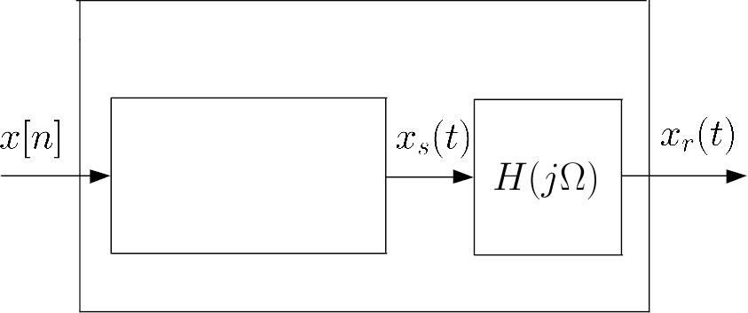
obtain
, and it corresponds to
Reconstruction
. Process of transforming back to
DC converter
sequence to
impulse train
conversion
Fig.4.7: Block diagram of DC converter
From Fig.4.6, is
Y. Chen
Page 14
Semester A, 2022-2023

Slide 15
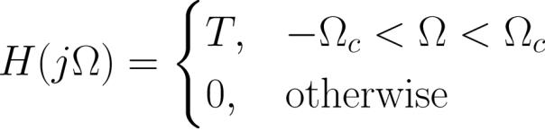





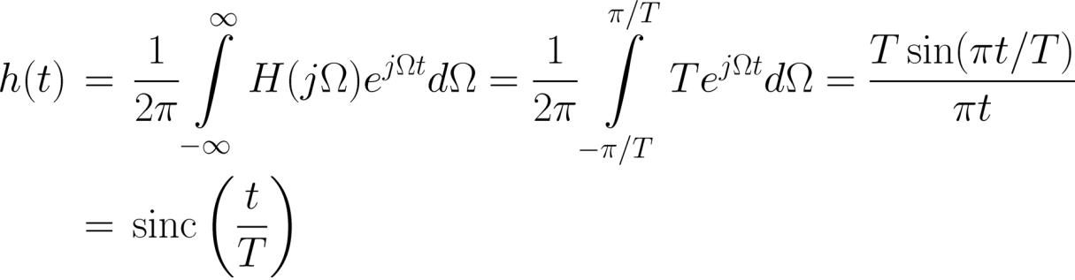
(4.8)
where
, which is a lowpass filter
For simplicity, we set as the average of and
:
(4.9)
and
To get , we take inverse Fourier transform of
use Example 2.5:
(4.10)
Y. Chen
Page 15
Semester A, 2022-2023

Slide 16


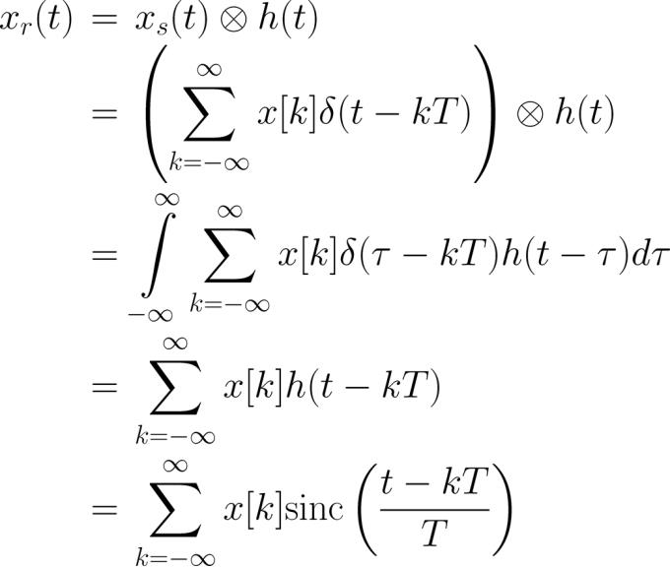
where
Using (2.23)-(2.24), (4.2) and (2.11)-(2.12), is:
(4.11)
Y. Chen
Page 16
Semester A, 2022-2023

Slide 17

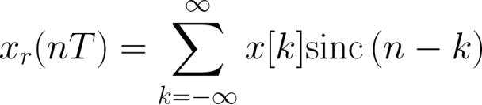
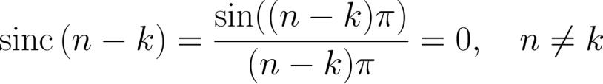


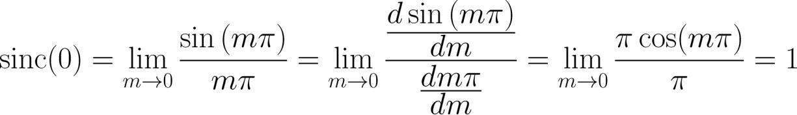
which holds for all real values of
The interpolation formula can be verified at
:
(4.12)
(4.13)
It is easy to see that
For , we use
’s rule to obtain:
(4.14)
Substituting (4.13)-(4.14) into (4.12) yields:
Y. Chen
Page 17
Semester A, 2022-2023

Slide 18







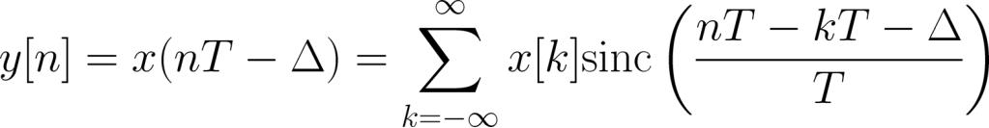

(4.15)
which aligns with
Example 4.3
Given a discrete-time sequence
. Generate its
time-delayed version which has the form of
where
and is a positive integer. Applying
(4.11) with
:
By employing a change of variable of
:
Y. Chen
Page 18
Semester A, 2022-2023

Slide 19
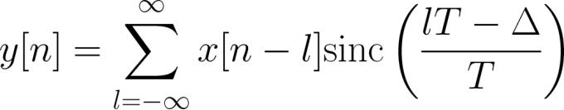

Is it practical to get y[n]?
Note that when
, the time-shifted signal is simply
obtained by shifting the sequence by samples:
Y. Chen
Page 19
Semester A, 2022-2023

Slide 20
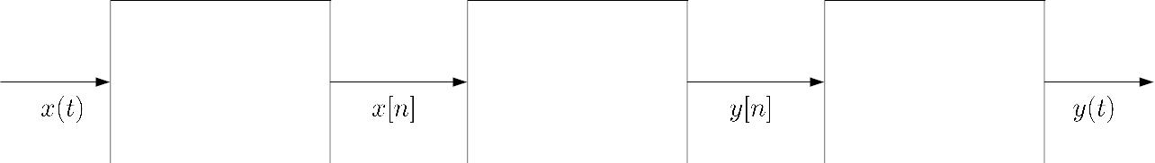

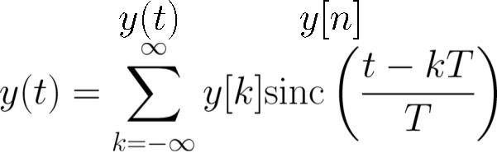

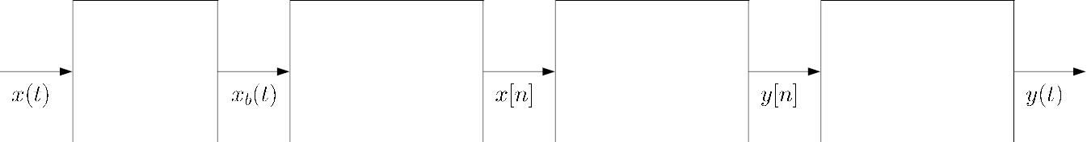
Sampling and Reconstruction in Digital Signal Processing
CD converter
digital signal
processor
DC converter
Fig.4.8: Ideal digital processing of analog signal
. CD converter produces a sequence from
. is processed in discrete-time domain to give
. DC converter creates from according to (4.11):
(4.16)
anti-aliasing
filter
analog-to-digital
converter
digital signal
processor
digital-to-analog
converter
Fig.4.9: Practical digital processing of analog signal
Y. Chen
Page 20
Semester A, 2022-2023

Slide 21


. may not be precisely bandlimited  a lowpass filter or
anti-aliasing filter is needed to process
. Ideal CD converter is approximated by AD converter
. Not practical to generate
. AD converter introduces quantization error
. Ideal DC converter is approximated by DA converter
because ideal reconstruction of (4.16) is impossible
. Not practical to perform infinite summation
. Not practical to have future data
. and are quantized signals
Y. Chen
Page 21
Semester A, 2022-2023

Slide 22








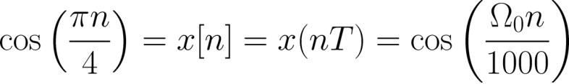

Example 4.4
Suppose a continuous-time signal
is sampled at
a sampling frequency of 1000Hz to produce :
Determine 2 possible positive values of , say, and .
Discuss if
or
will be obtained when passing
through the DC converter.
Answer: According to (4.1) with
is easily computed as:
s:
Y. Chen
Page 22
Semester A, 2022-2023

Slide 23
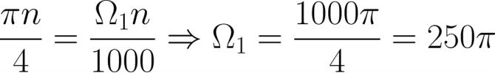

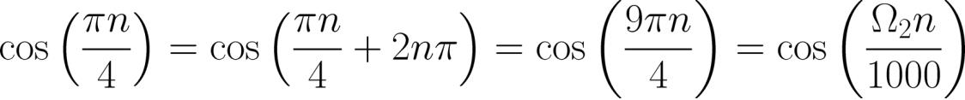
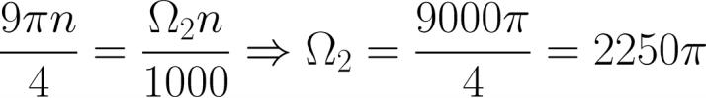
can be obtained by noting the periodicity of a sinusoid:
As a result, we have:
This is illustrated using the MATLAB code:
O1=250*pi;
O2=2250*pi;
%first frequency
%second frequency
Ts=1/100000;%successive sample separation is 0.01T
t=0:Ts:0.02;%observation interval
x1=cos(O1.*t); %tone from first frequency
x2=cos(O2.*t); %tone from second frequency
Y. Chen
Page 23
Semester A, 2022-2023

Slide 24
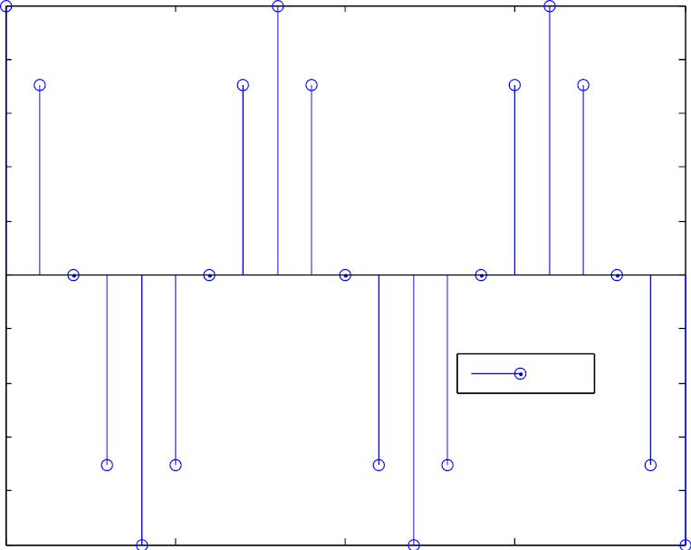
There are 2001 samples in 0.02s and interpolating the
successive points based on plot yields good approximations
1
0.8
0.6
0.4
0.2
0
-0.2
-0.4
-0.6
-0.8
-1
x[n]
0
5
10
n
15
20
Fig.4.10: Discrete-time sinusoid
Y. Chen
Page 24
Semester A, 2022-2023

Slide 25
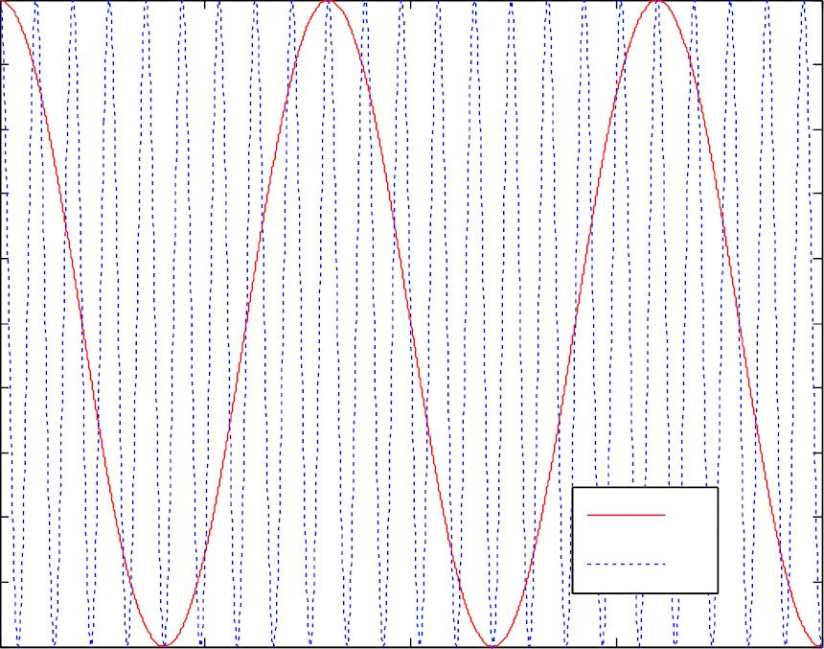
1
0.8
0.6
0.4
0.2
0
-0.2
-0.4
-0.6
-0.8
-1
₁
₂
0
0.005
0. 01
t
0.015
0. 02
Fig.4.11: Continuous-time sinusoids
Passing through the DC converter only produces
Y. Chen
Page 25
Semester A, 2022-2023

Slide 26










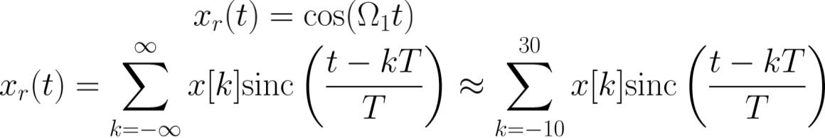

but not
The Nyquist frequency of
sampling frequency without aliasing is
is
and hence the
does not
Given
Hz or
,
correspond to
We can recover
and Nyquist rate for
because the Nyquist frequency
are and
Based on (4.11),
is:
with
s
The MATLAB code for reconstructing
is:
Y. Chen
Page 26
Semester A, 2022-2023

Slide 27

n=-10:30;
x=cos(pi.*n./4);
T=1/1000;
%add 20 past and future samples
%sampling interval is 1/1000
for l=1:2000 %observed interval is [0,0.02]
t=(l-1)*T/100;%successive sample separation is 0.01T
h=sinc((t-n.*T)./T);
xr(l)=x*h.'; %approximate interpolation of (4.11)
end
We compute 2000 samples of in
s
The value of each at time t is approximated as x*h.'
where the sinc vector is updated for each computation
Y. Chen
Page 27
Semester A, 2022-2023

Slide 28
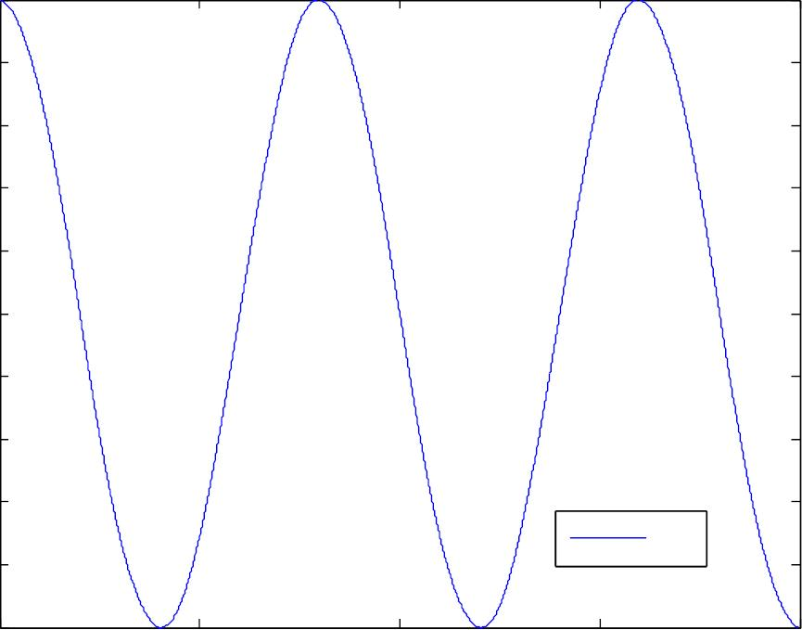
1
0.8
0.6
0.4
0.2
0
-0.2
-0.4
-0.6
-0.8
-1
x_{r}(t)
0
0.005
0.01
t
0.015
0.02
Fig.4.12: Reconstructed continuous-time sinusoid
Y. Chen
Page 28
Semester A, 2022-2023

Slide 29
Example 4.5
Play the sound for a discrete-time tone using MATLAB. The
frequency of the corresponding analog signal is 440 Hz
which corresponds to the A note in the American Standard
pitch. The sampling frequency is 8000 Hz and the signal has
a duration of 0.5 s.
The MATLAB code is
A=sin(2*pi*440*(0:1/8000:0.5));%discrete-time A
sound(A,8000);
%DA conversion and play
Note that sampling frequency in Hz is assumed for sound.
The frequencies of notes B, C#, D, E and F# are 493.88 Hz,
554.37 Hz, 587.33 Hz, 659.26 Hz and 739.99 Hz,
Y. Chen
Page 29
Semester A, 2022-2023

Slide 30
respectively. You can easily produce a piece of music with
notes: A, A, E, E, F#, F#, E, E, D, D, C#, C#, B, B, A, A.
Y. Chen
Page 30
Semester A, 2022-2023

